Slide 1

Krishna’s Gita
Survey review and possible features

Slide 2
Approach to comprehensive understanding
Using prior knowledge
Identifying main idea and summarization
Making inferences
Repeated reading
Visualization
Collaborative learning

Slide 3
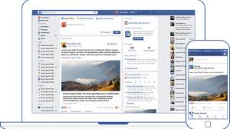
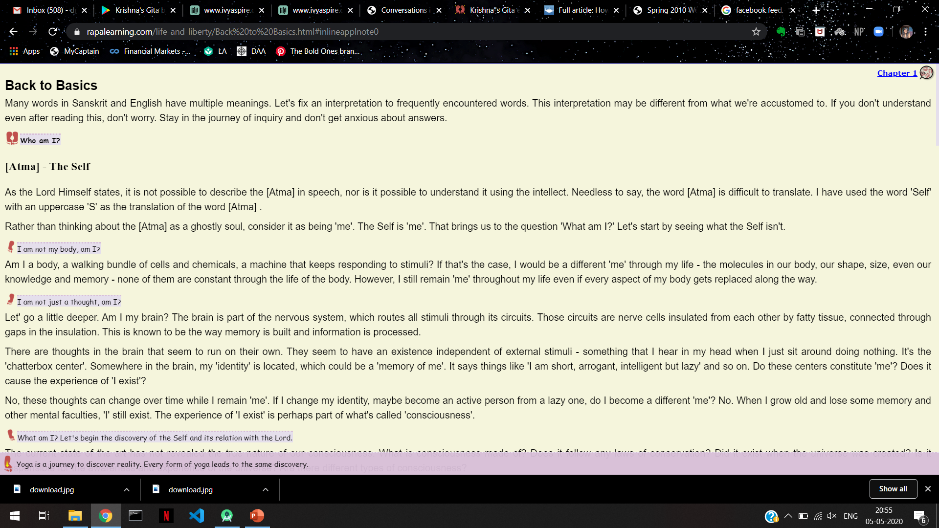

Verse Feed
A verse feed for each individual dependent on what they’ve read before and new parts that they can explore.

Slide 4


Search/ask questions
A search bar where users can:
Search for specific verses.
Ask questions that they need answers for from the Gita.
The answers will include verses from the Gita.

Slide 5
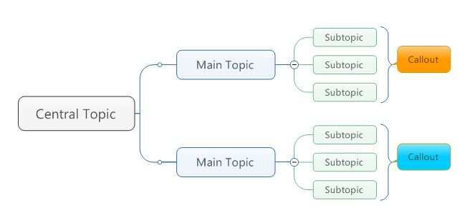

Main idea/topic
The verses displayed as answers to questions asked and the ones on the feed can be displayed as:
The verse number.
The main idea will be a gist of the verse. Example:
Work according to your nature. Don't be anxious about your goal. Your work will continue.
This can be expanded to view the whole verse in detail.

Slide 6

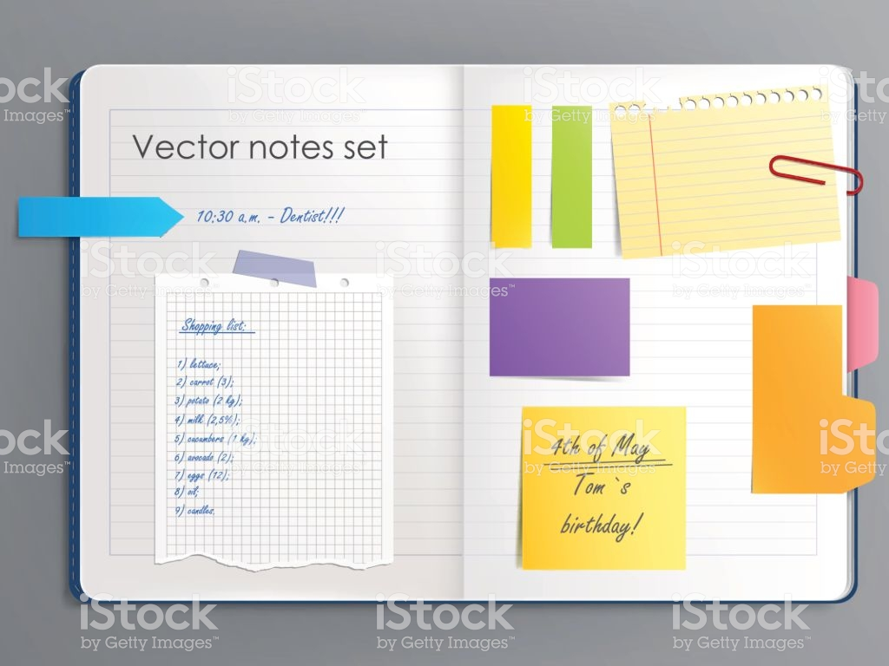
Save what you read
Each user can have a personal notebook on the app/website to save specific verses, to read again later. Rather than searching for it each time.
The user can also make notes (Example: write the verse in simple languages that they can understand) for themselves.

Slide 7


Logos and intra links
Logos for each section (if possible) to make it more visually pleasing and attractive.
Intra links connecting one verse to another where the connection is required.

Slide 8

Answer sequence
Each answer verse provided for a specific question can be upvoted or downvoted by the users based on how accurate and helpful it was.
The next time the same question is asked, the answers are displayed in descending order of votes.

Slide 9


Personal progress
Have a virtual plant that grows based on the user’s mental health and the verses read.
The users can water the plant whenever they feel like they’ve leant something and grown.

Slide 10
Thank you
- Drishti Hoskote

